Slide 1
Linear Regression
Eng Teong Cheah

Slide 2
Objective
Key ingredients in a machine learning model are training data, a loss function, an optimization algorithm, and quite obviously, the model itself.

Slide 3
Contents
Linear Regression

Slide 4

Linear Regression

Slide 5
Basic Elements of Linear Regression

Slide 6
Basic Elements of Linear Regression
Linear regression, which dates to Gauss and Legendre, is perhaps the simplest, and by far the most popular approach to solving regression problems. What makes linear regression linear is that we assume that the output truly can be expressed as a linear combination of the input features.

Slide 7

Training Data
Typically, we will use n to denote the number of samples in our dataset. We index the samples by I, denoting each input data point as and the corresponding label as

Slide 8


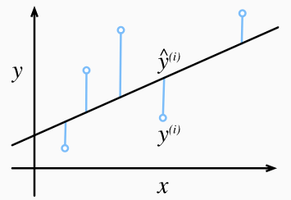

Loss Function

Slide 9

Analytic Solution

Slide 10

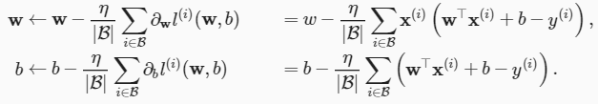
Gradient descent

Slide 11
Model Prediction

Slide 12
From Linear Regression to Deep Networks

Slide 13
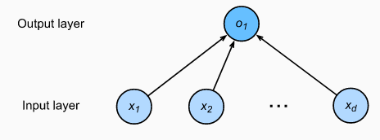
Neural Network Diagram
Linear regression is a single-later neural network.

Slide 14
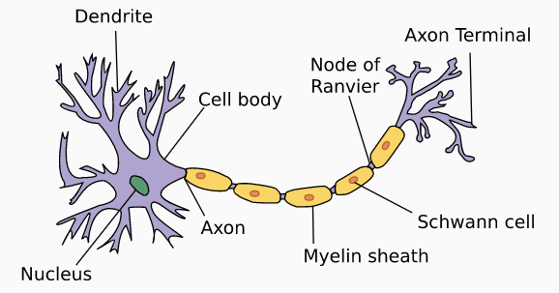
Biology
The real neuron

Slide 15
Thanks!
Does anyone have any questions?
Twitter: @walkercet
Blog: https://ceteongvanness.wordpress.com

Slide 16
Resources
Dive into Deep Learning

